Slide 1

SGX security & performance evaluation
Tõnis Lusmägi School of Information Technologies / Department of Computer Systems
Tallinn University of Technology
6.6.2019

Slide 2
outline
Problems
SGX Security Review
SGX Setup
SGX Performance Benchmarking
Motivations
Break SGX
Improve SGX
Share findings
2
Notes:
Research Objects

Slide 3

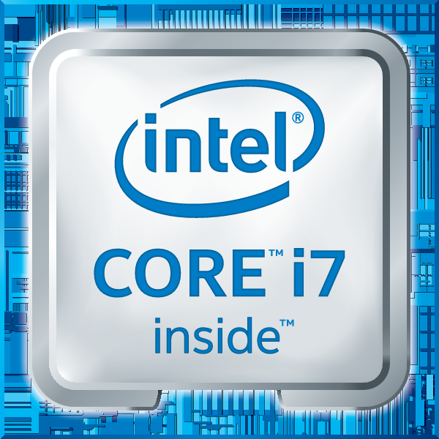
What is sgx?
SGX - Secure Guard Extensions
2 Keys in CPU’s eFuses
3 instructions containing 30 leaf functions
SGX1
SGX2
OVERSUB
Software Stack
SGX SDK
SGX PSW
SGX Driver
Eclipse Plugin
SGX can be applied to regular desktop applications or embedded
SGX encrypted memory region - Enclave
Hardware-based encryption
Skylake
6th gen
3
Notes:
SGX is, consists of and offers
PSW is services (AESMD)
SDK is libs, debugger, etc
Driver – kernel module

Slide 4
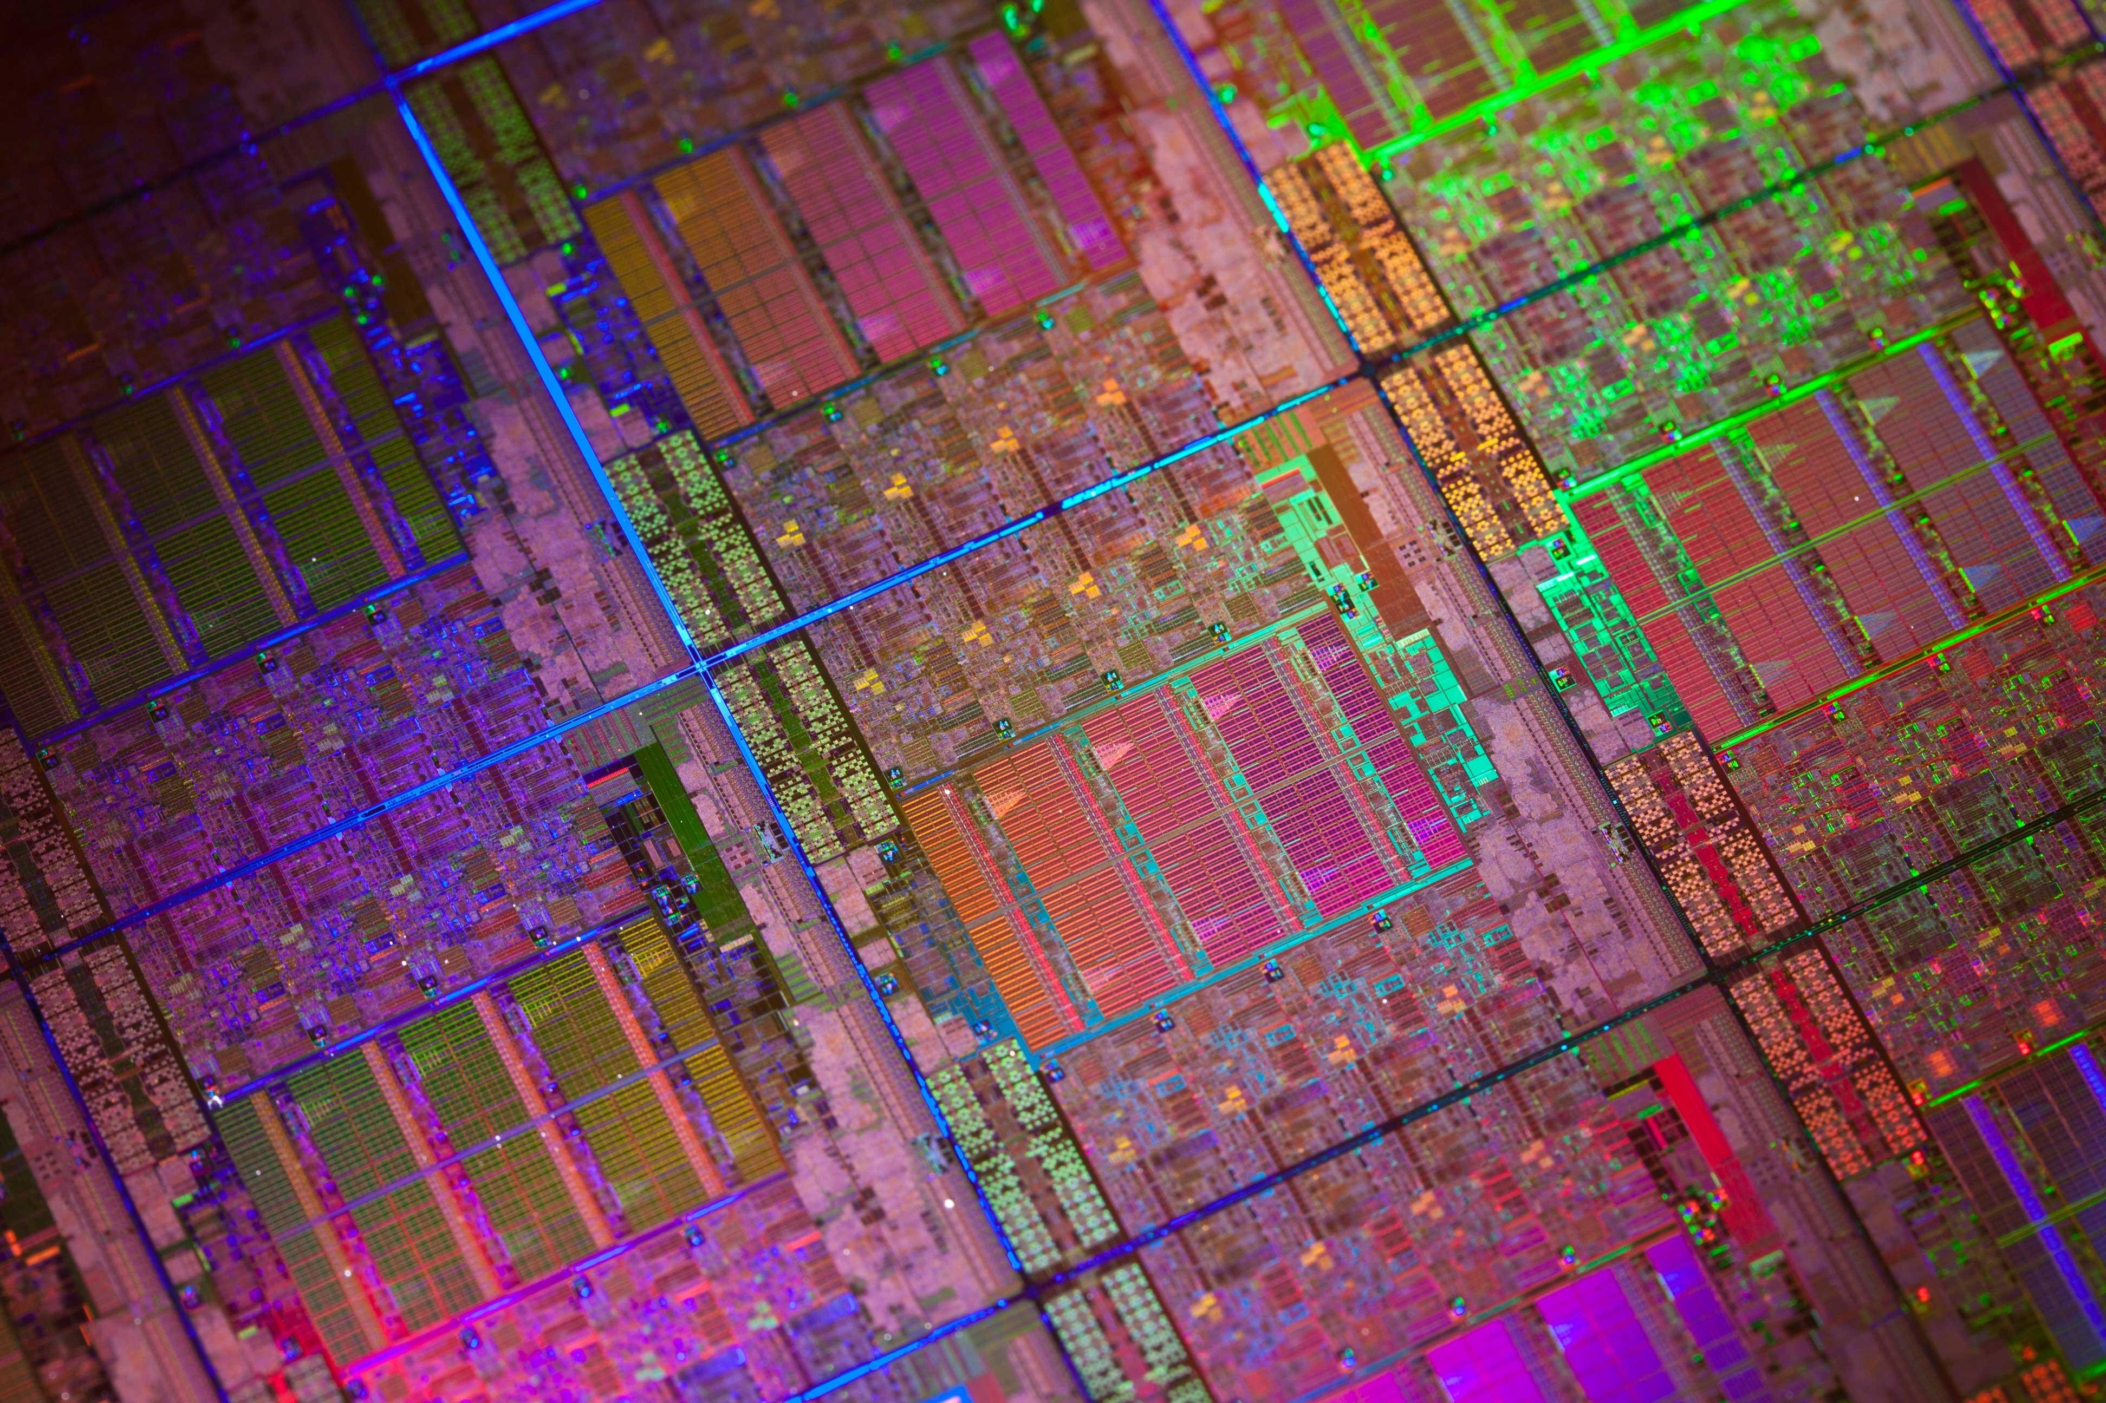

SGX Security
Notes:
https://icdn3.digitaltrends.com/image/intel-xeon-silicon.jpg

Slide 5

SGX Structure from hardware level to system level
EPC - Enclave Page Cache
EPC pages have 4 KB granularity
EPC up to 128 MB in size
5
Notes:
EPC – Virtual Address Space of the Encrypted Memory Area

Slide 6
SGX security model
SGX enclave memory cannot be read or written from outside the enclave regardless of privilege level and CPU mode.
This shields the enclave from the OS, SMM and VMM, or another enclave.
Protection against software and hardware attacks
NO security guarantees against side channel attacks or reverse engineering!
6
Notes:
CPU mode is 32bit or 64bit
IA-32 Architecture protection mechanism

Slide 7
SGX literature review
Side Channels
Return-Oriented Programming (ROP)
Speculative Execution Side Channels
Controlled-Channel Attacks: Page Faults
AsyncShock
Software Grand Exposure
T-SGX mitigation
CacheZoom
Cache Attacks on Intel SGX
Branch Shadowing
High-Resolution Side Channels
Malware Guard Extension
Stacco
Foreshadow
Foreshadow-NG
Practical Enclave Malware
RIDL (Rogue In-Flight Data Load)
Hacking in Darkness: ROP
Telling secrets without Page Faults
TSX mitigation: Cloak
7
Notes:
Microarchitectural Data Sampling (MDS)

Slide 8



Speculative execution attacks
8

Slide 9

System Setup
Notes:
https://capsule8.com/wp-content/uploads/2019/02/linux-hardening.png

Slide 10

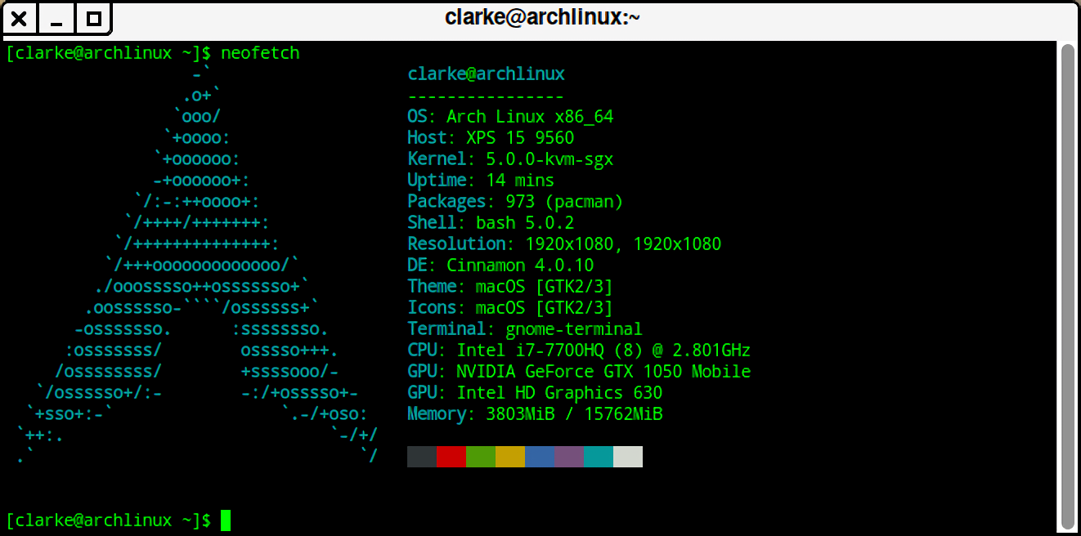
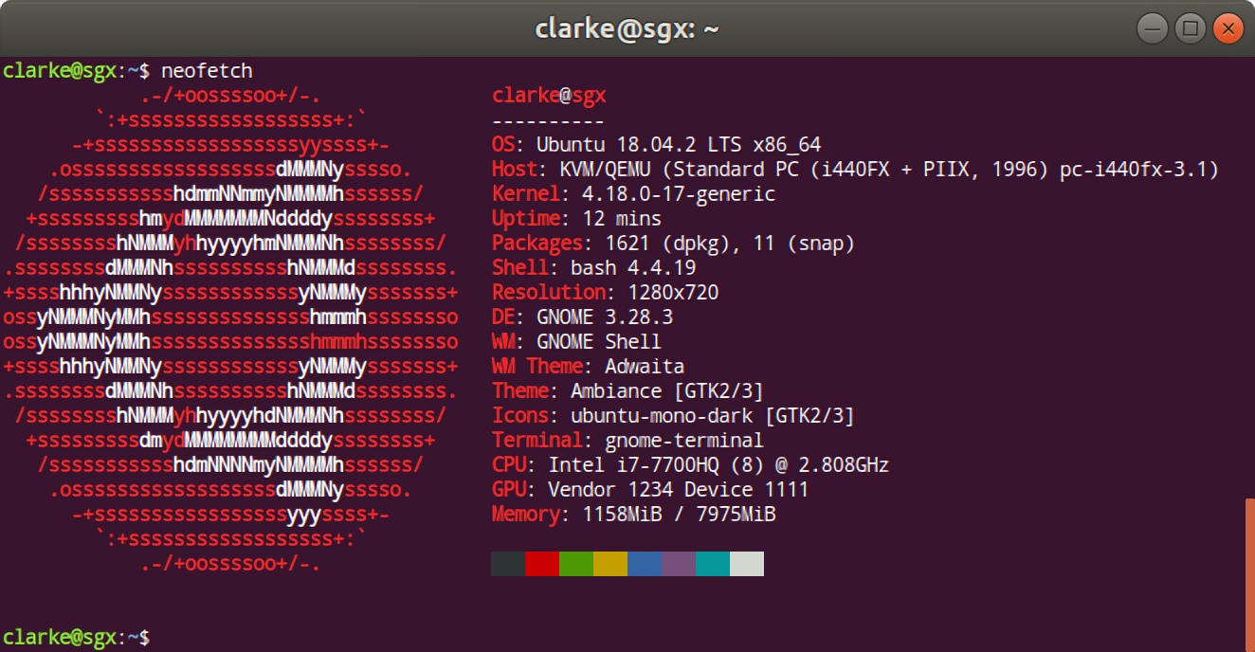
hardware and operating systems
For benchmarking
10
Notes:
https://www.francescospighi.com/dell-xps-15-2017-review/2017/02/

Slide 11

SGX performance
Notes:
https://icdn2.digitaltrends.com/image/intel-10th-gen.jpg

Slide 12
Testing Specifications
Identified Edge Routine Methods
Regular Calls
HotCalls
Switchless Calls
Hypothesis
Host System outperforms Guest System, Switchless Calls outperform HotCalls.
Testing Methodology
Based on “Regaining Lost Cycles with HotCalls: A Faster Interface for SGX Secure Enclaves” – O. Weisse, V. Bertacco, T. Austin & Intel’s Switchless Example
CLFLUSH(), RDTSCP() – similar to FLUSH+RELOAD
6.4M measurements
Cold Cache CDF graphs, Median Results, 99th Percentile
12
GitHub.com/SGX-Performance
Notes:
CDF – Cumulative Distribution Function

Slide 13
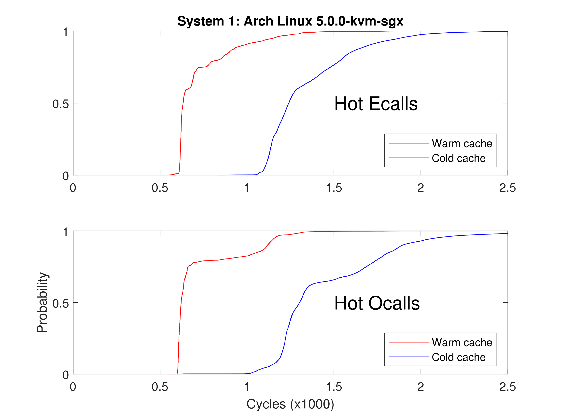
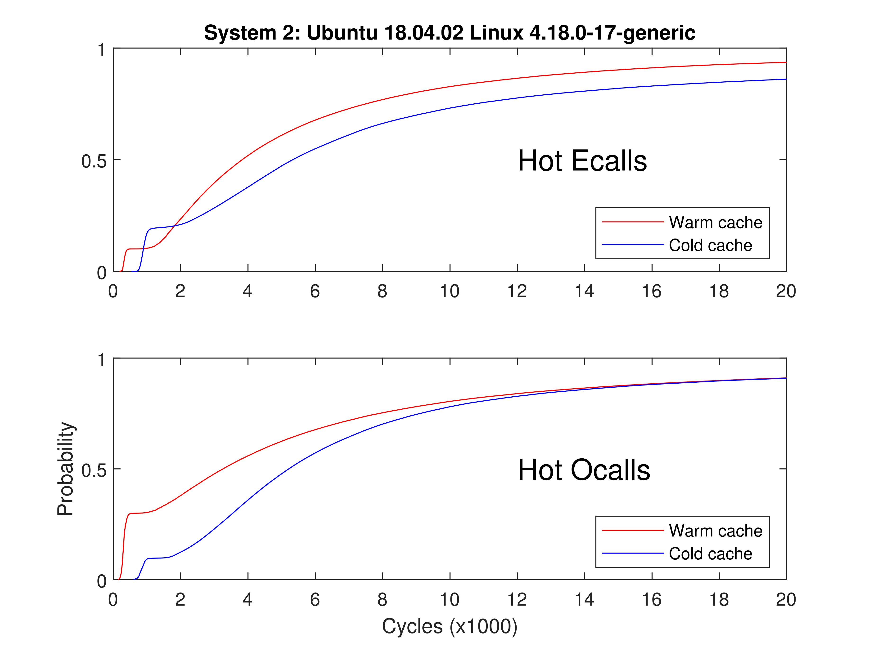
Example Cdf
Undefined behavior !!!
13

Slide 14
Microbenchmark results generalized
Hypothesis: Host System outperforms Guest System, Switchless Calls outperform HotCalls
Host System Generally Faster by 1.2X
HotCalls 12X faster than Regular Calls
Switchless Calls 10X faster than Regular Calls
System Calls 100X faster than Regular Calls
ANOMALY ! DISCOVERY?
Hypothesis: Not Confirmed!
14

Slide 15

SGX summary

Slide 16
SGX Research summary
Current Research Concludes
SGX Amplifies Side Channel Attacks
Quantum resistant cryptography primitives NOW!
Regular SGX Calls cause a performance degradation of 88-105X compared to System Calls!
Performance degradation is reduced to 10X by using Switchless Calls.
Significance
Performance benchmarking uncovered a potential scientific discovery! Accidental FLUSH+RELOAD!
Future research
Examine if discovery matches with RIDL’s (MDS) fingerprint
Preliminary research shows YES!
SGX Virtualization Research
16

Slide 17
SGX security & performance evaluation
Tõnis Lusmägi School of Information Technologies / Department of Computer Systems
Tallinn University of Technology
6.6.2019

Slide 18
Sgx Implications and features
Rules and limitations
Native C/C++
Calls to OS and SO through SGX edge routines
Synchronization using SGX SDK libraries
Limited threading support
Dynamic memory allocation
Static linking of libraries
Features at a glance
Attestation
Sealing
Switchless calls
Key Sharing & Separation
Notes:
Dyn mem alloc. – Max heap size set at enclave creation SO – shared Object

Slide 19
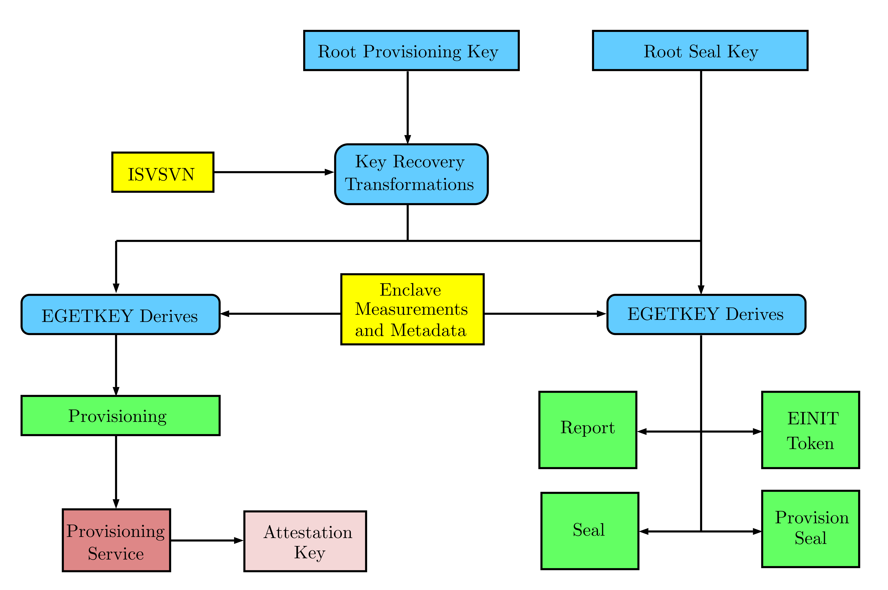
SGX Key hierarchy
Intel knows
CPU knows
Key transformation
Hardware level
Software level
Key derivation
Enclave requests key
Notes:
Software Vendor Security Version Number (ISVSVN)

Slide 20
SGX Encryption schemes and primitives + Hash
Symmetric
AES-CTR – Advanced Encryption Standard – Counter
AES-GCM – Advanced Encryption Standard – Galois/Counter Mode
CMAC – Cipher-based Message Authentication Code
HMAC – Hash-based Message Authentication Code
Asymmetric
ECC – Elliptic-Curve Cryptography
ECC-ECDSA – Elliptic-Curve Cryptography – Elliptic Curve Digital Signature Algorithm
RSA-PKCS#1 v1.5 – Rivest–Shamir–Adleman – Public-Key Cryptography Standards
SHA-1 – Secure Hash Algorithm – 1
SHA-2 – Secure Hash Algorithm – 2

Slide 21
Setting up SGX systems for benchmarking
SGX inside CPU
Core
Xeon
Pentium
Celeron
SGX must be enabled in the firmware (UEFI)
Building & Installing SGX software stack
SGX SDK
SGX PSW
SGX Driver
SGX Eclipse Plugin
SGX Virtualization – Experimental Software !!!

Slide 22
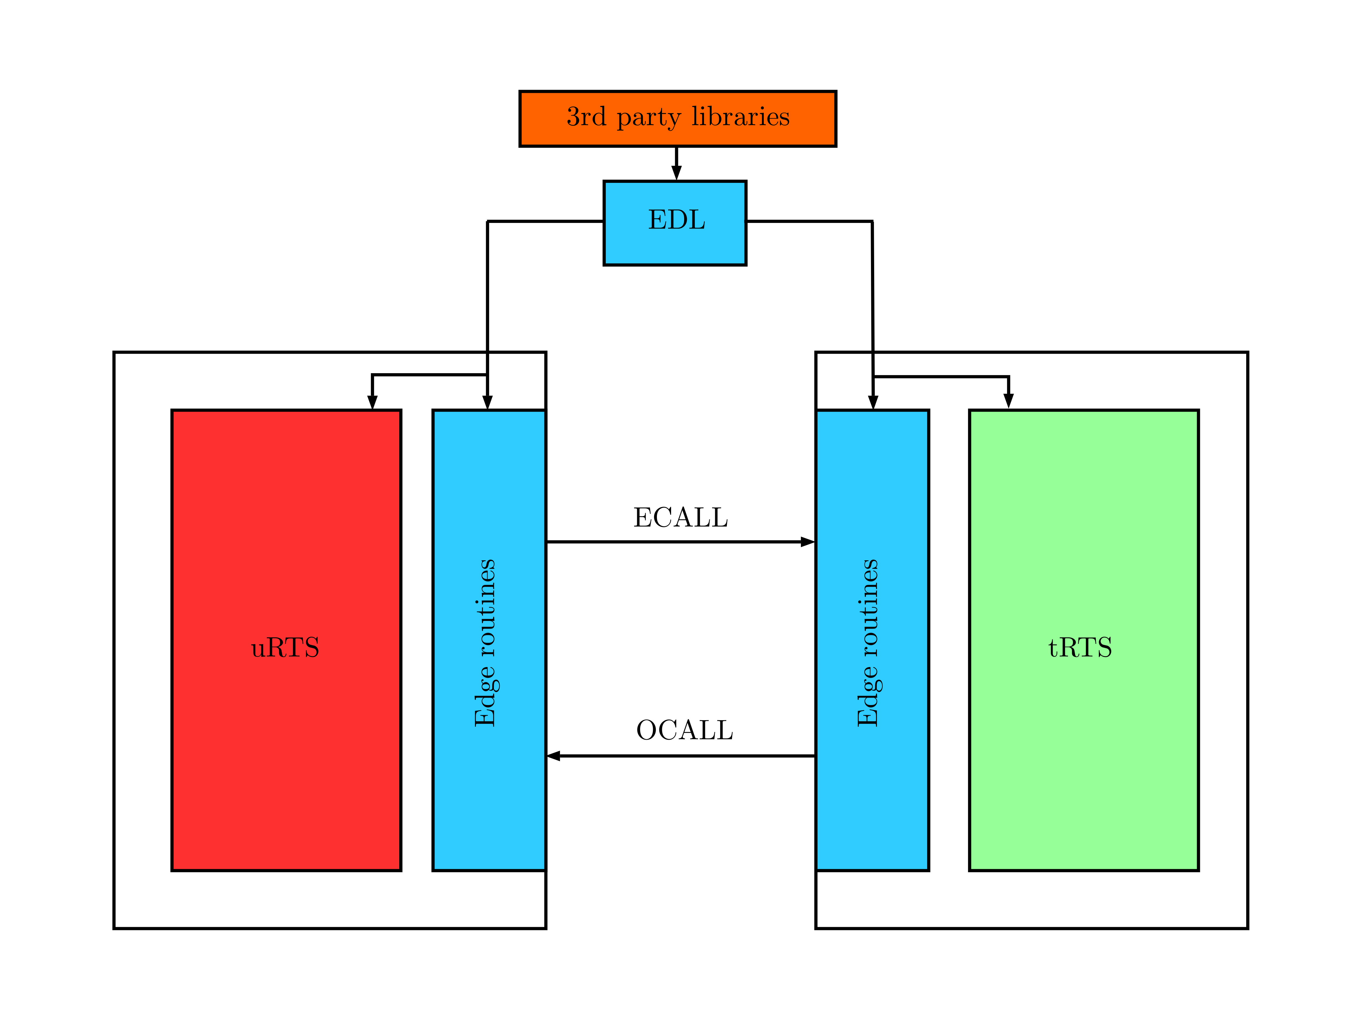
SGX hypothetical generic Run-time system
Untrusted Run-Time System (uRTS)
Trusted Run-Time System (tRTS)
Edge Routines
3rd Party Libraries
EDL proxy file
Describes a typical SGX program
5

Slide 23
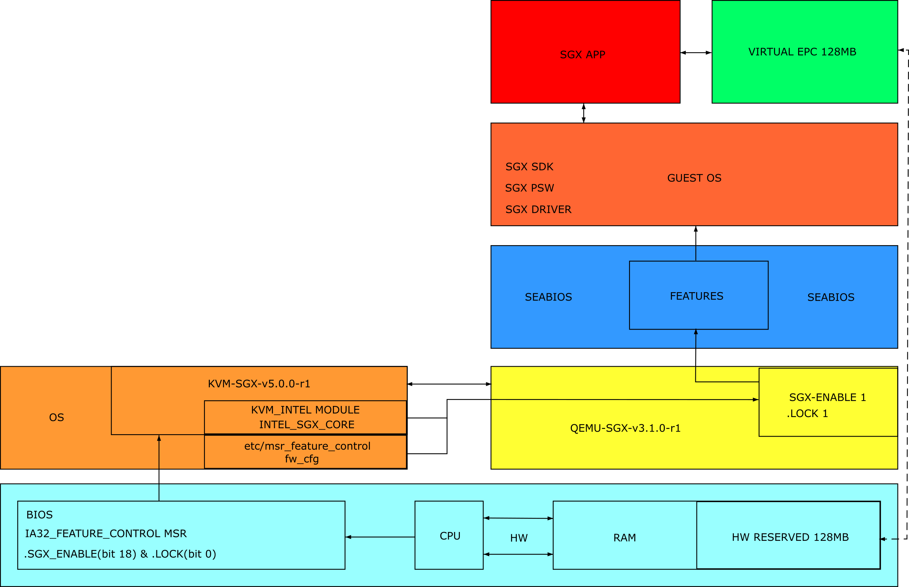
SGX VIRTUALIZATION using KVM-SGX & QEMU-SGX

Slide 24
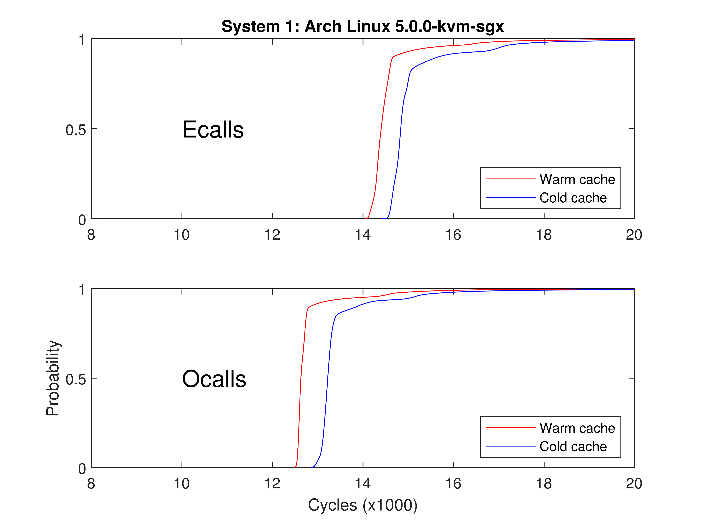
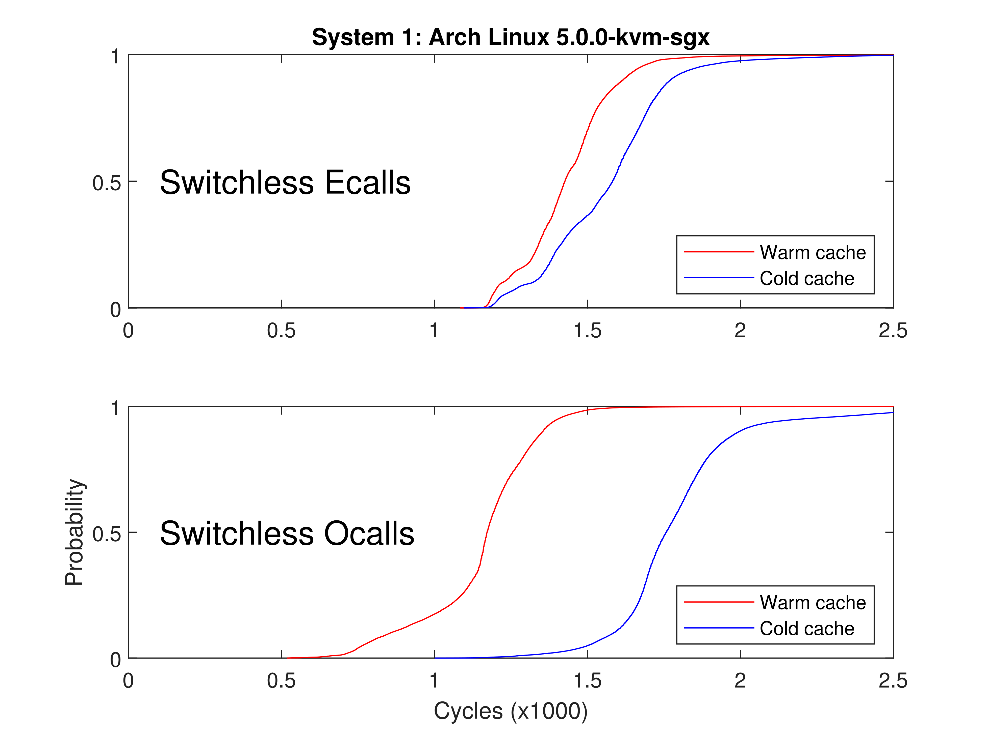
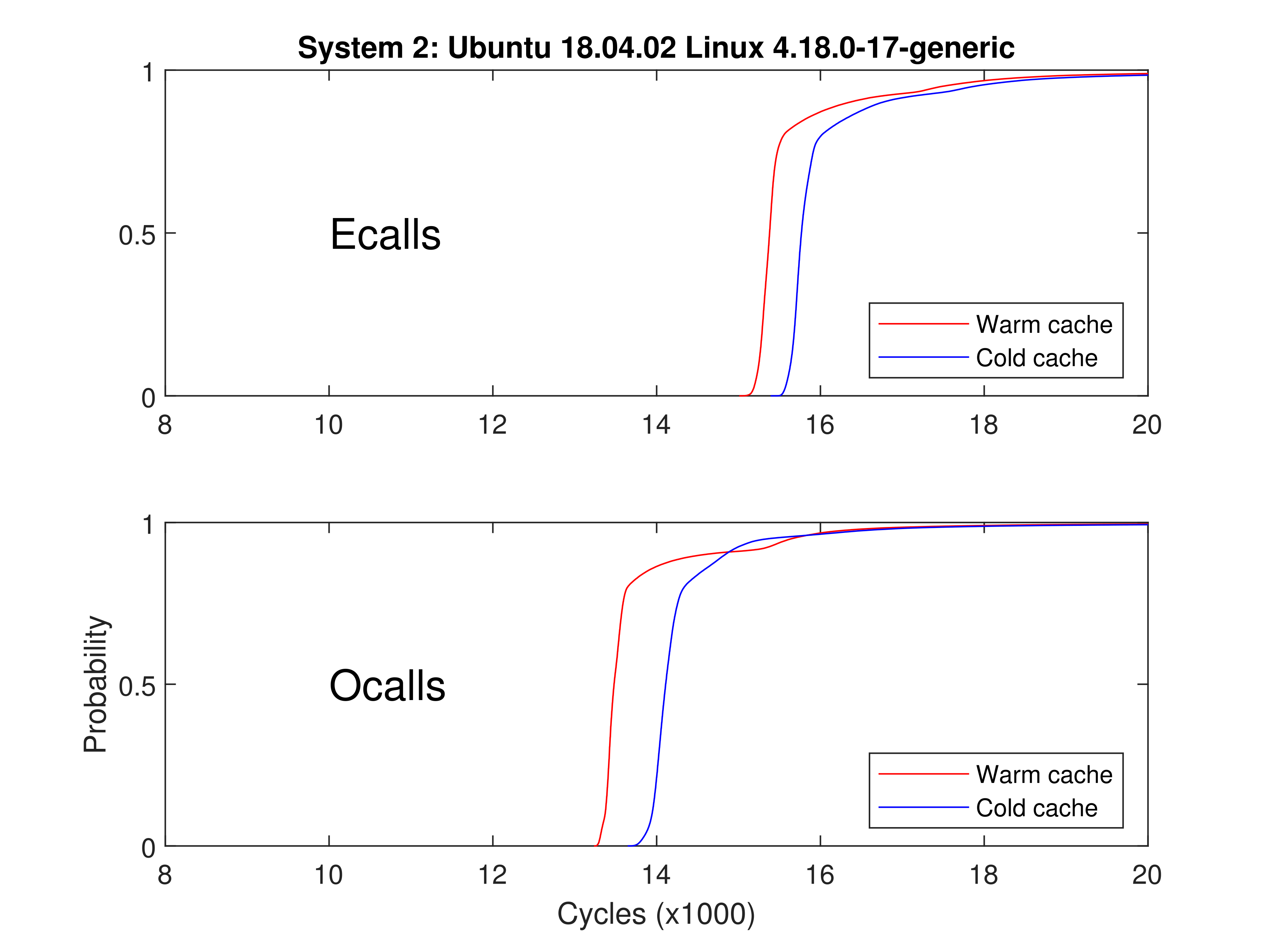
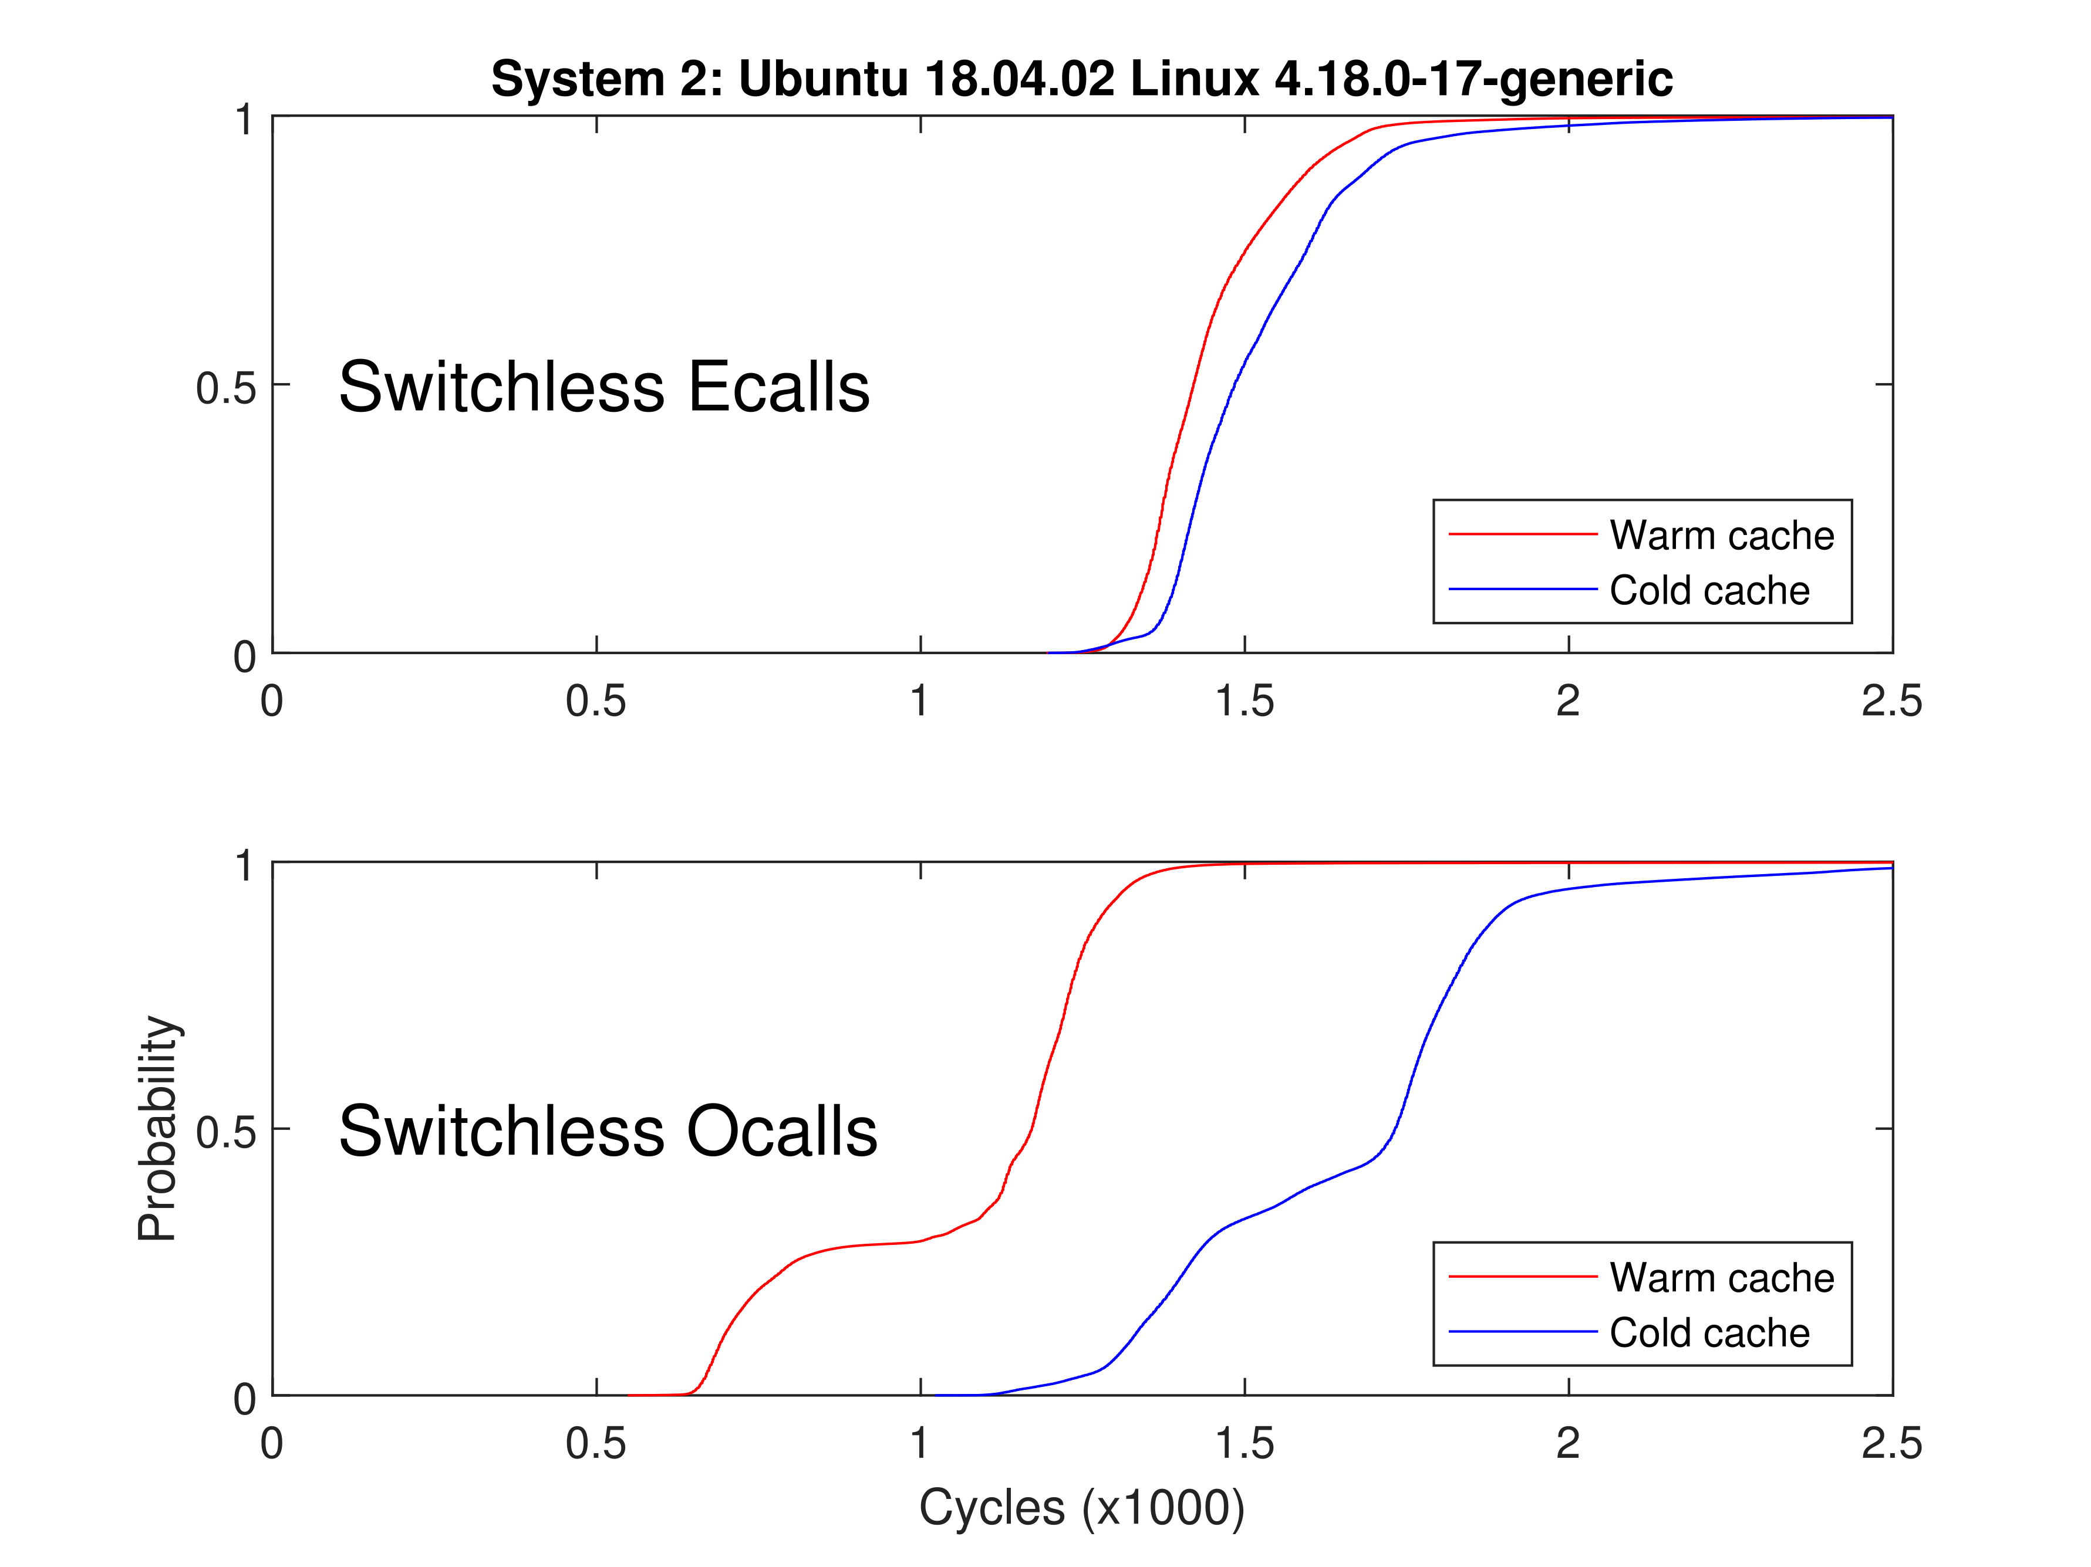

Slide 25
SGX Research summary
My Research Conclusion
Side Channels Amplify SGX Attacks
Quantum/proof cryptography NOW
Speculative execution vulnerabilities calling for a new architecture
ROP is practical and dangerous
SGX Virtualization is Hot
Scientific Discovery
Significance
RIDL
Future research
Possibly New Exploit Stemming from Current Work
SGX Virtualization Research

Slide 26




Evolving into SGX

